Slide 1
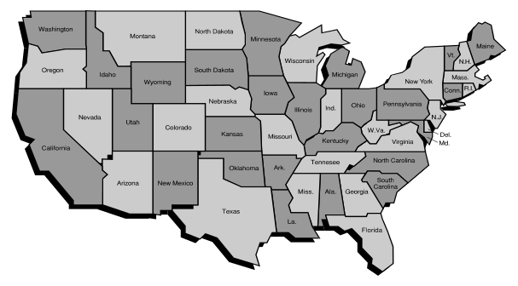
Chapter 6
STATE DEPENDENT SYSTEMS
Markov Analysis
Load Sharing Systems
Standby Systems
Chapter 6
Notes:
Chapter 5 discussed system reliability based upon the assumption of mutual independence among the components. This chapter looks at several important cases in which there is dependency among the components. In order to analyze these dependent situations, more powerful mathematics, namely Markov processes, must be used along with the assumption that the component failure distributions are exponential.

Slide 2
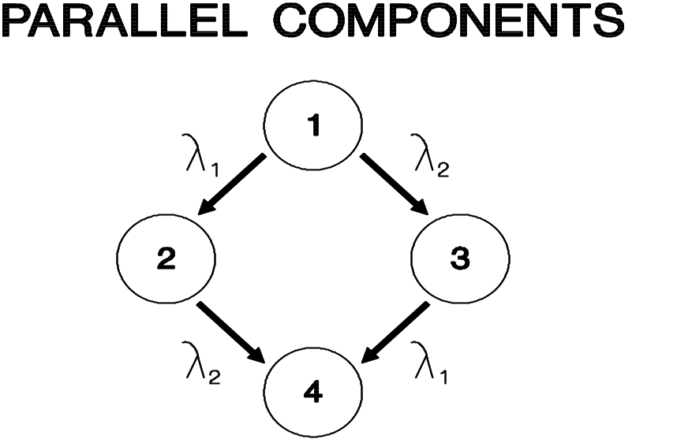
Markov Analysis
Independent Components
STATE COMPONENT 1 COMPONENT 2
1 operating operating
2 failed operating
3 operating failed
4 failed failed
Chapter 6
Notes:
We will illustrate the technique by solving the two-component, independent serial and parallel system. This is the same system that was solved in Chapter 5. Hopefully, will we get the same result. We began by defining the four possible states of the system as shown. Under the assumption of constant failure rates, the transition (failure) rate from one state to another state is illustrated by a rate diagram. Lambda 1 is the failure rate of component 1 and lambda 2 is the failure rate of component 2.

Slide 3
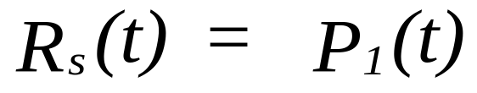
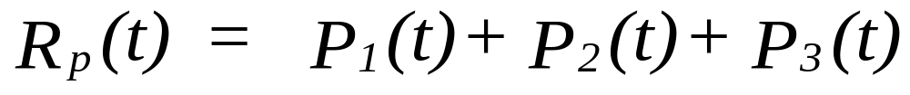
Independent Components
Let Pi(t) = probability of being in state i at time t
For two components in series:
For two components in parallel:
Chapter 6
Notes:
Once the four possible states of the system have been defined, the probability of being in each state as a function of time must be determined. Since state one is the only state in which both components are operating, then the probability of being in state one must be the serial reliability. Since states one, two, and three have at least one component operating then the probability of being in any of these three states must be the redundant reliability.

Slide 4

State Equation
rate out of state 1
into state 2
rate out of state 1
into state 3
Prob of being in state 1 at time t+ t is equal to the prob of being in state 1
at time t and not transitioning to states 2 or 3 in time t.
Chapter 6
Notes:
In order to solve for these four probabilities, a system of four equations must be formulated and solved. An equation can be established for each state by setting the probability of being in a state at time t plus delta t equal to the probability of being in that state at time t and not transitioning to another state in time delta t, or being in another state at time t that transitions into the current state in time delta t. For state one, the system can only transition out of the state.

Slide 5
More State Equation
P₁(t) = prob of being
in state 1 at time t
prob of being in state 1 at time t and
transitioning to state i in time t
prob of being in state 1 at time t + t
Chapter 6
Notes:
In order to solve for these four probabilities, a system of four equations must be formulated and solved. An equation can be established for each state by setting the probability of being in a state at time t plus delta t equal to the probability of being in that state at time t and not transitioning to another state in time delta t, or being in another state at time t that transitions into the current state in time delta t. For state one, the system can only transition out of the state.

Slide 6
Even More State Equations
State 2:
State 3:
State 4:
Chapter 6
Notes:
For states two and three, the system can transition both into and out of the state. For state 4, transitions are only into the state. There is no leaving state 4! In each of these equations, lambda delta t times the probability of being in state i at time t is the joint probability of being in state i at time t and transitioning (i.e. a failure occurring) to another state in time delta t.

Slide 7
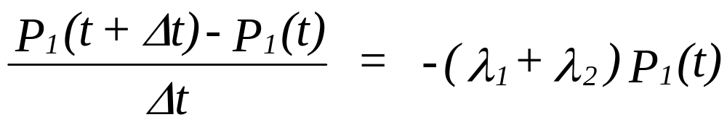
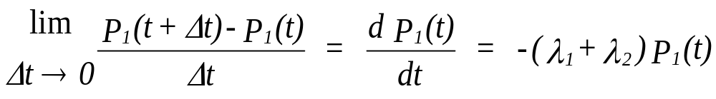
Rewriting the Equation for State 1:
then
Chapter 6
Notes:
By rearranging terms as shown and then taking the limit, by definition the left hand side of the equation becomes the derivative of P(t) with respect to t. This provides us with a differential equation.

Slide 8
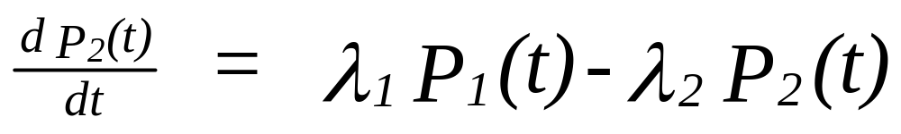

Differential Equations or States 2 & 3
A fourth differential equation is not needed. Why?
Chapter 6
Notes:
For each state, a corresponding differential equation can be obtained. However, since the sum of the probabilities of being in each of the four states at time t must equal one, then only three differential equations are necessary to solve a four state problem. At this point you may wish to go ahead and solve this system of differential equations. If not, continue to the next slide.

Slide 9
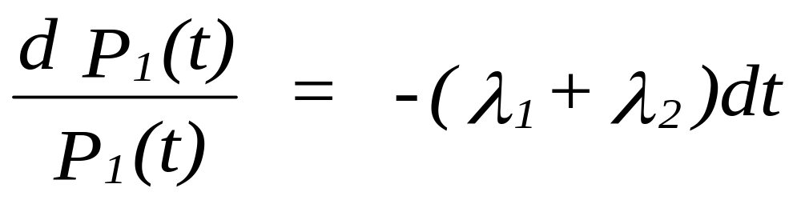
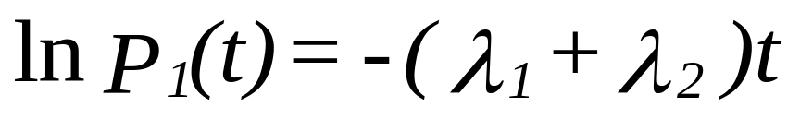
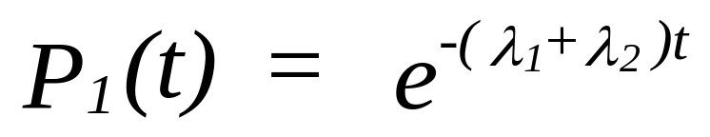
Solution
From the Equation for State 1:
Integrating both sides:
or
Chapter 6
Notes:
The first equation can be solved using the variables separable method.

Slide 10
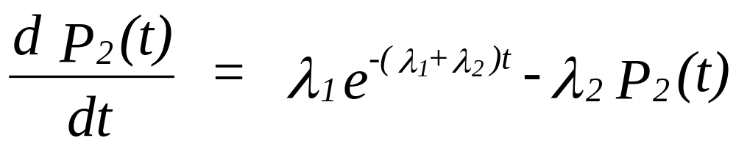

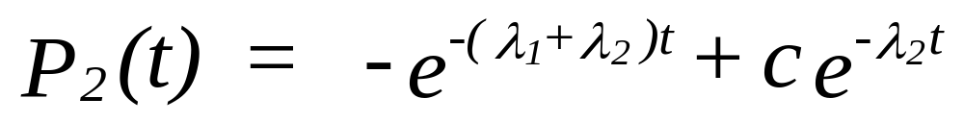
Solution
Substituting the solution for P₁(t) into the State 2 Equation:
or
with P₂(0) =0, then c = 1
P₃(t) is derived in the same manner!
Chapter 6
Notes:
Substituting the solution to equation one into equation two, equation 2 can be solved using an integrating factor. If you do not remember how integrating factors are used, you may wish to consult your undergraduate text on differential equations. You did keep your text, didn’t you? Equation three is solved for in the same way.

Slide 11
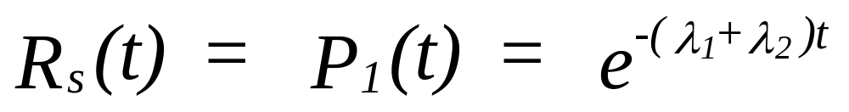
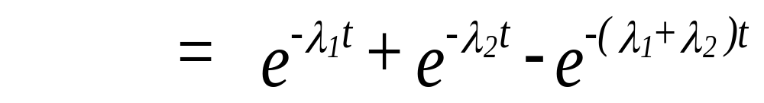
Finally
For a series system:
For a parallel system:
Chapter 6
Notes:
Look back to Chapter 5 and make sure that the solutions obtained are identical to those found earlier. The independence assumption needed in Chapter 5 was not applied here.

Slide 12
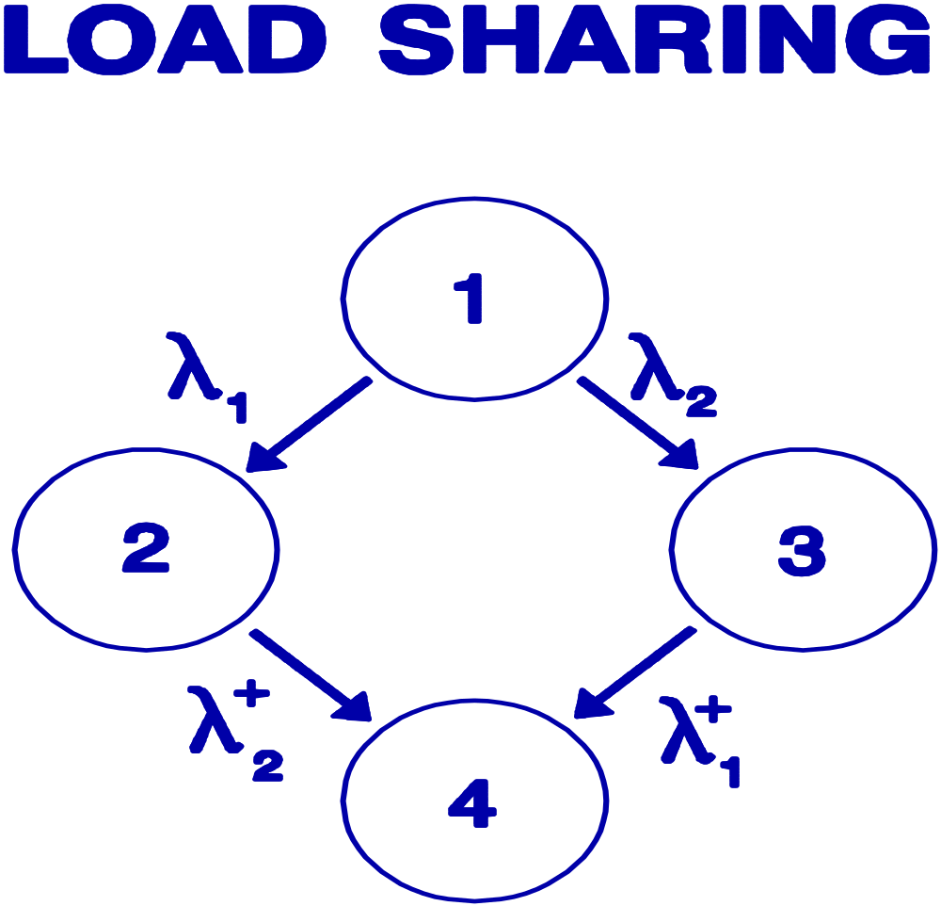
Load-Sharing System
Assume Constant Failure Rates
State Operating
1 - Both components
2 - Component 2
3 - Component 1
4 - Neither component
Chapter 6
Notes:
A load sharing system is one in which both component contribute to the operation of the system each having its own failure rate. However, if one component fails, the other component’s failure rate increases (represented by the superscript plus sign). The increase is due presumably to the increased burden of the remaining component. The rate diagram for this system is shown above. System reliability is the probability of being in states one, two, or three. Dependency is a result of the failure rate of one component being dependent upon the state (operating or failed) of the other component. This problem cannot be solved using the approach in Chapter 5.

Slide 13
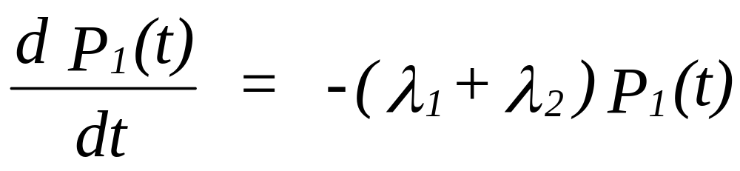
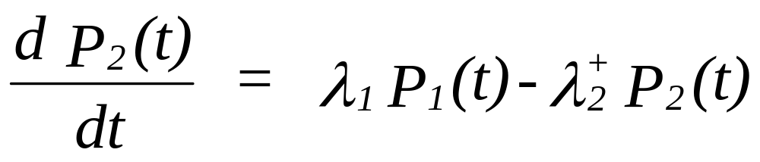
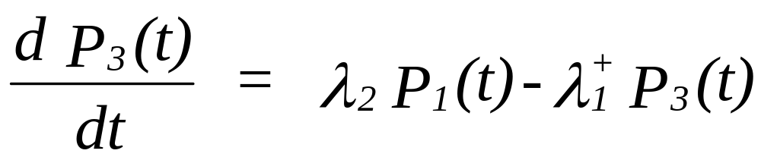
Load-Sharing Systems
P_{i}(t) = probability of being in state i at time t
Remember: P₁(t) + P₂(t) + P₃(t) +P₄(t) = 1 !
Chapter 6
Notes:
For each state, a differential equation can be formulated. Once you see how these equations are derived, they can be immediately constructed from the rate diagram. The rate of change of the probability of being in state i with respect to time is equal to the rate in to state i from state j times the probability of being in state j minus the rate out of state i times the probability of being in state i. You see that don’t you?

Slide 14

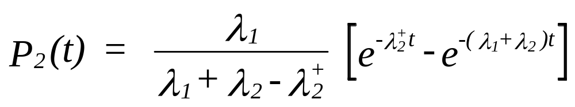
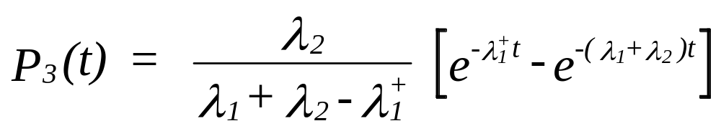
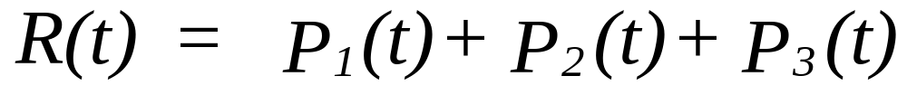
Load-Sharing Systems
Solution:
Chapter 6
animated
Notes:
The system of equations has the above solution. Details may be found in the text.

Slide 15
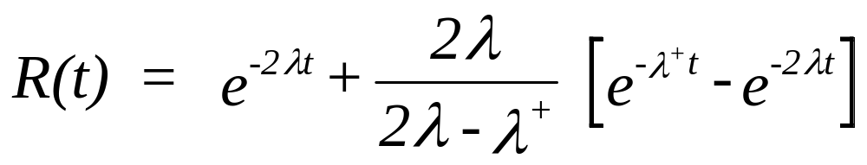
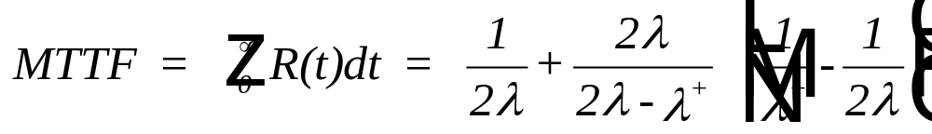
Load-Sharing Systems
If we let λ₁ = λ₂ = λ and λ₁⁺ = λ₂⁺ = λ⁺ , then
Chapter 6
Notes:
R(t) is somewhat simpler if both components are identical (i.e. have the same failure rates). Our favorite trick, integrate the reliability function to obtain the MTTF. Can you find the MTTF for the more general case given on the previous slide? I am betting you can do it – if not now certainly on the midterm.

Slide 16
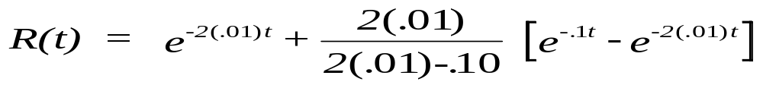
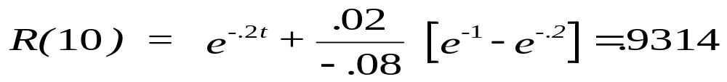
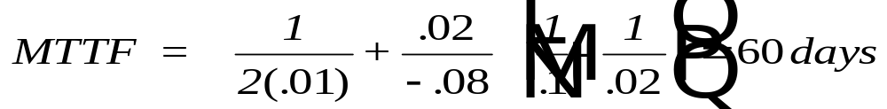
Load-Sharing Systems - example
Two generators provide electrical power. If either fails,
the other will continue to provide power. However, the
increased load results in a higher failure rate of .10 failures
per day. When both generators are on-line, the failure rate
is .01 failures per day.
Chapter 6
animated
Notes:
Let’s make this come alive with an example.

Slide 17
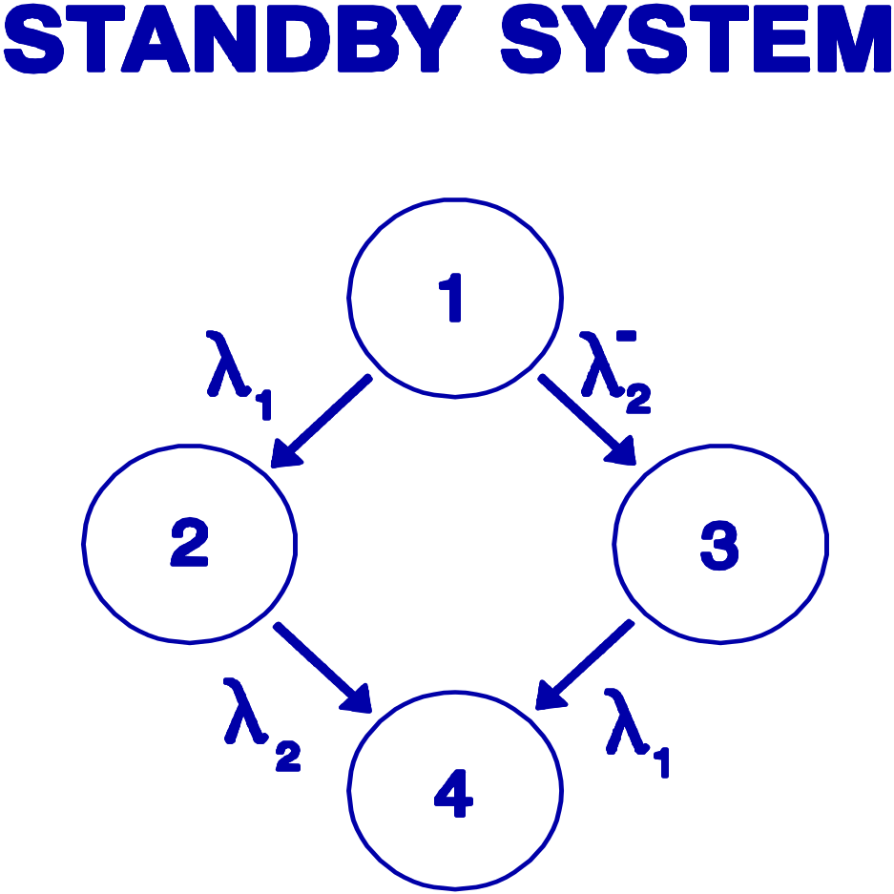
Standby Systems
Assume Constant Failure Rates
State Operating
1 - Component 1 with
component 2 in standby
2 - Component 2
3 - Component 1,
component 2 failed in standby
4 - Neither component
Chapter 6
Notes:
A standby system is similar to the load-sharing system. We assume that the standby component has a reduced failure rate (indicated by the superscript minus sign) when in a standby mode. For some system, there may be no failure when in standby. In this case, State 3 does not occur.

Slide 18
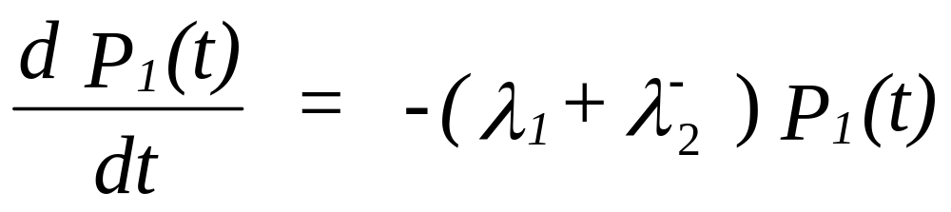
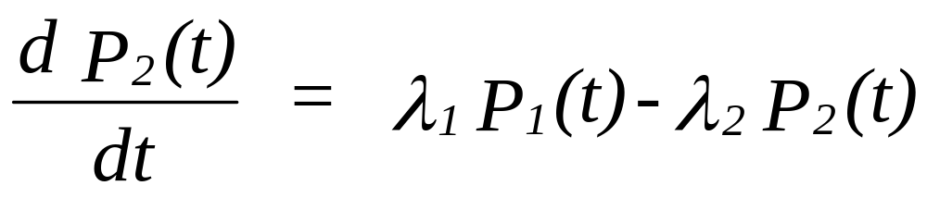
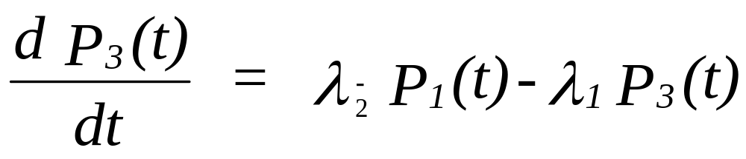
Standby Systems - Model
Remember: P₁(t) + P₂(t) + P₃(t) +P₄(t) = 1 !
Chapter 6
Notes:
Can you write down the set of equations from the rate diagram?

Slide 19
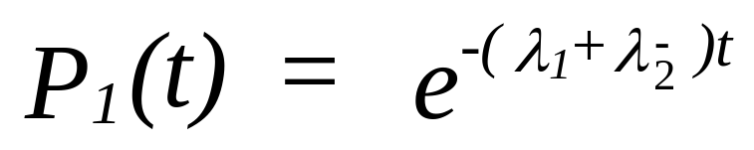
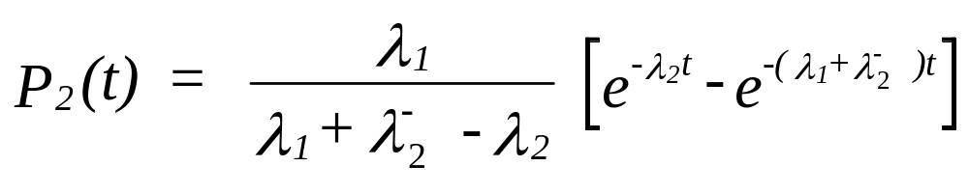
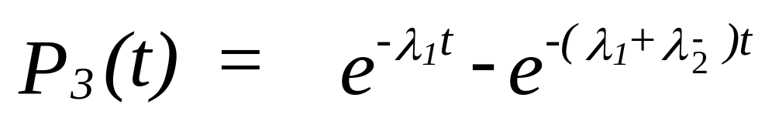
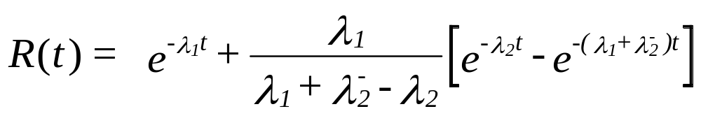
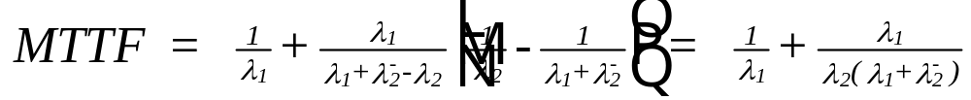
Standby Systems- Solution
Chapter 6
Notes:
Details of the solution may be found in the text. Check and see that the MTTF is correct by integrating R(t).

Slide 20
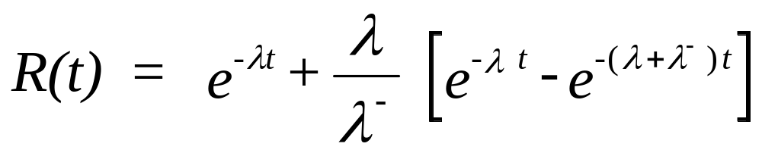
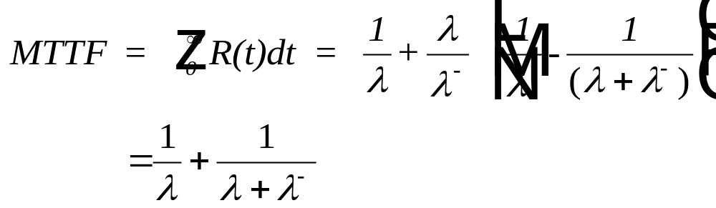
Standby Systems - identical units
If we let λ₁ = λ₂ = λ and λ₂⁻ = λ⁻ , then
Chapter 6
Notes:
For identical units (same failure rate when operating), the formulae simplify.

Slide 21
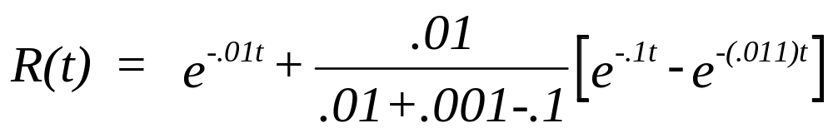
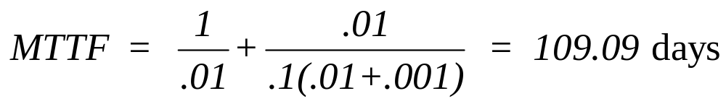
Standby Systems- Example 6.2
An active generator has a .01 failure rate (failures per day). An older standby generator has a .001 failure rate while in standby and a .10 failure rate when on-line. Determine the system reliability for a planned 30 day usage and compute the system MTTF.
Chapter 6
animated
Notes:
The necessary example.

Slide 22
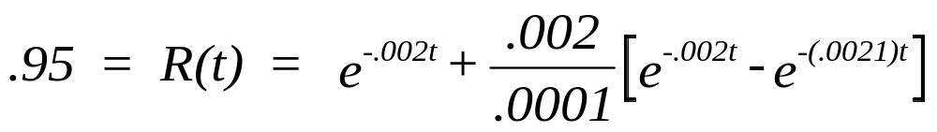
Standby Systems- Example 6.3
For a 2 component stand-by system, determine the design life based upon a 95% reliability where both units are identical with λ = .002 failures per hour and λ- = .0001 failures per hour.
by trial and error
R(100) = .982
R(200) = .935
R(150) = .961
R(175) = .949
R(173) = .950.
Chapter 6
animated
Notes:
Yet another example. Verify the results shown here.

Slide 23

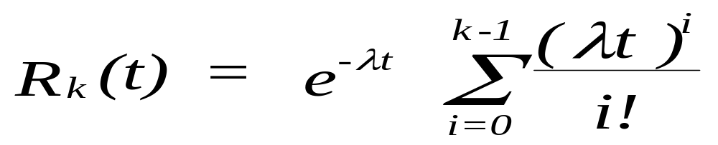
Standby Systems- Identical Units
Assume k identical units with CFR - a primary and k-1 units in standby with no failures in standby.
The system fails when the kth failure occurs. The time to kth
failure is the sum of k exponential failure times:
T_{failure} = T₁ + T₂ + . . . + T_{k}
The sum of k independent and identically distributed exponential
random variables with parameter is gamma with parameters
and k and MTTF = k/λ.
Chapter 6
Notes:
A different approach can be taken if there are k-1 identical units in standby.
This approach makes use of the fact that the sum of k independent, exponential random variables is equal to the Erlang (a special case of the gamma) distribution. Review the discussion in Chapter 3 on the gamma distribution. When k = 2, show that the same result is obtained with the two-component standby system when there are no failures in standby. Be sure you know how to apply the above formula.

Slide 24
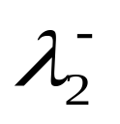
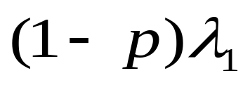
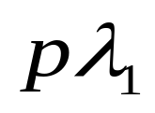

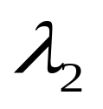

Standby Systems- Switching Failures
1
2
3
4
Chapter 6
Notes:
An enhancement to the two-component standby system is to allow for a failure to occur when switching from the primary unit to the standby unit. The probability of an on-demand failure of the switching mechanism is p. From the rate diagram, can you set up the necessary equations?

Slide 25
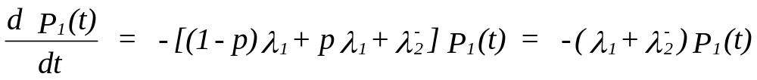
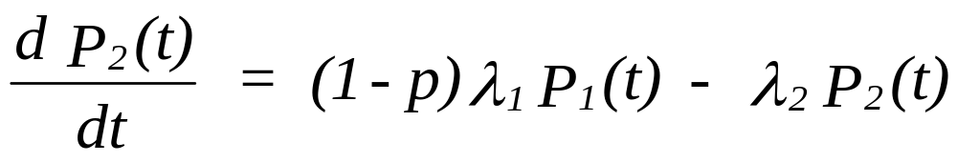
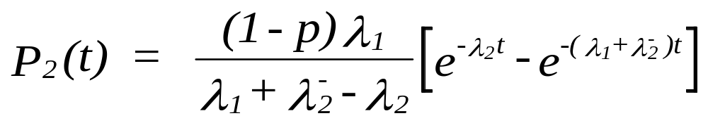
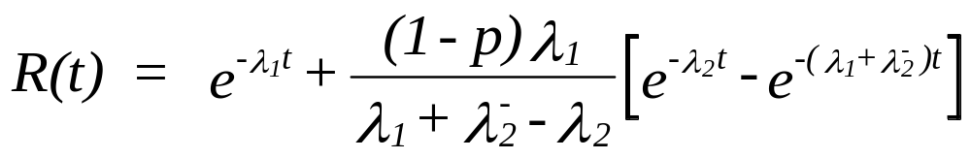
Standby Systems- Switching Failures
Only Change
Chapter 6
Notes:
Here are part of the equations and the solution. The (1-p) term is the only change from the earlier model. Does R(t) of make sense. What happens when p = 0 and p = 1?

Slide 26
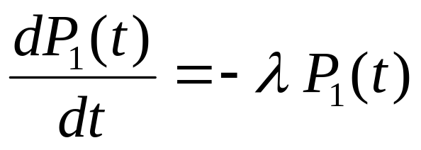



Three-Component System
State Unit 1 Unit 2 Unit 3
1 on-line standby standby
2 failed on-line standby
3 failed failed on-line
4 failed failed failed
Chapter 6
animated
Notes:
A three component standby system with no failures in standby can be solved by using the differential equation approach or by using the gamma function approach.

Slide 27





Solution to 3 -component system
Chapter 6
Notes:
The solution. Look over the discussion in the textbook on Degraded Systems (section 6.4). At this point you should be able to follow the derivation. Then work the assigned problems in Chapter 6. For this offering of the course, Three-state Devices (section 6.5) will not be covered.

Slide 28

Bonus - Components in Series with Standby Redundancy - together at last
(Problem 6.24)
N identical components having failure rate λ with k in series
and N-k standby units:
note: kλt is the expected number of failures during time t of k
identical and active units in series. This becomes the mean of
a Poisson process. R_{sys}(t) is the equivalent to finding the probability
of no more than N-k failures (the number of standby or replacement
units) during time t. What is the MTTF?

Slide 29






Degraded Systems
fully operational state 1
degraded state 2
failed state 3
1
2
3

Slide 30



Degraded Systems Solution
R(t) = P₁(t) + P₂(t)

Slide 31





Three-State Devices
State 1
operating
1
2
State 2
failed 0pen
State3
failed short

Slide 32



Three State Devices Solution

Slide 33

The Last Slide (for now)
Next Class: Chapter 7
  Physical reliability,
  Covariate Model,
  Interference theory,
  and much, much more…
You will not want to miss the next reliability class. It promises to be the best ever.
Chapter 6

